Slide 1

Data Mining and information search: problems, algorithms, solutions Oleksandr Krakovetskyi CEO, DevRain Solutions @msugvnua, alex.krakovetskiy@devrain.com

Slide 2
About
CEO of DevRain Solutions – software development.
Microsoft Regional Director, Microsoft Most Valuable Professional.
Best Professional in Software Architecture (Ukrainian IT Award).
Ph.D. in Computer Science.
Community lead in Kyiv Smart City initiative, expert in Open Data.
Speaker and IT blogger.

Slide 3
Problem
Finding optimal paths for viewing results of information search
E.g. Resource 1-> Resource 14 -> Resource 20 (information / viewing time => MAX)

Slide 4
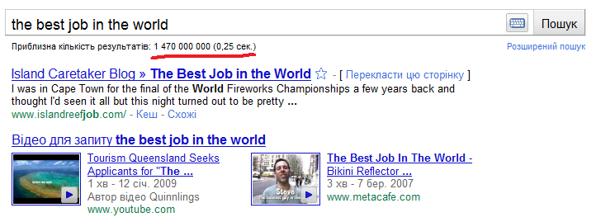
#1: A lot of information
“No information” problem is transformed to the “a lot of information” problem.
Amount of information increases every year in geometric progression.
Big data.

Slide 5
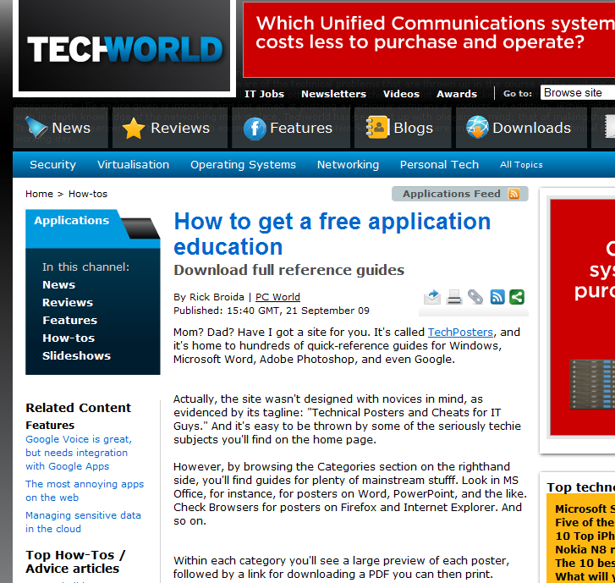
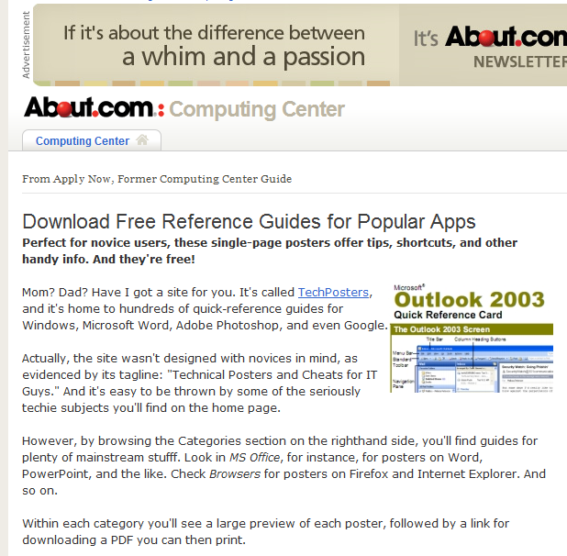
#2: Duplicates
Different chrome not the content.
Copyrighting and plagiarism.
Partially solved for news.

Slide 6
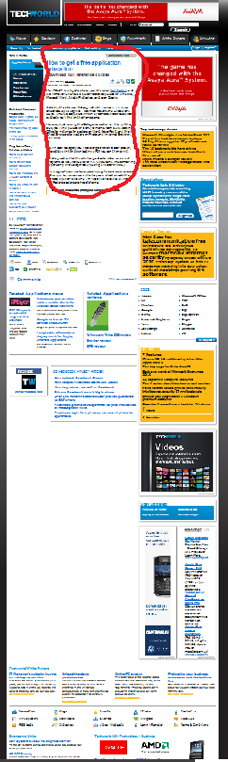
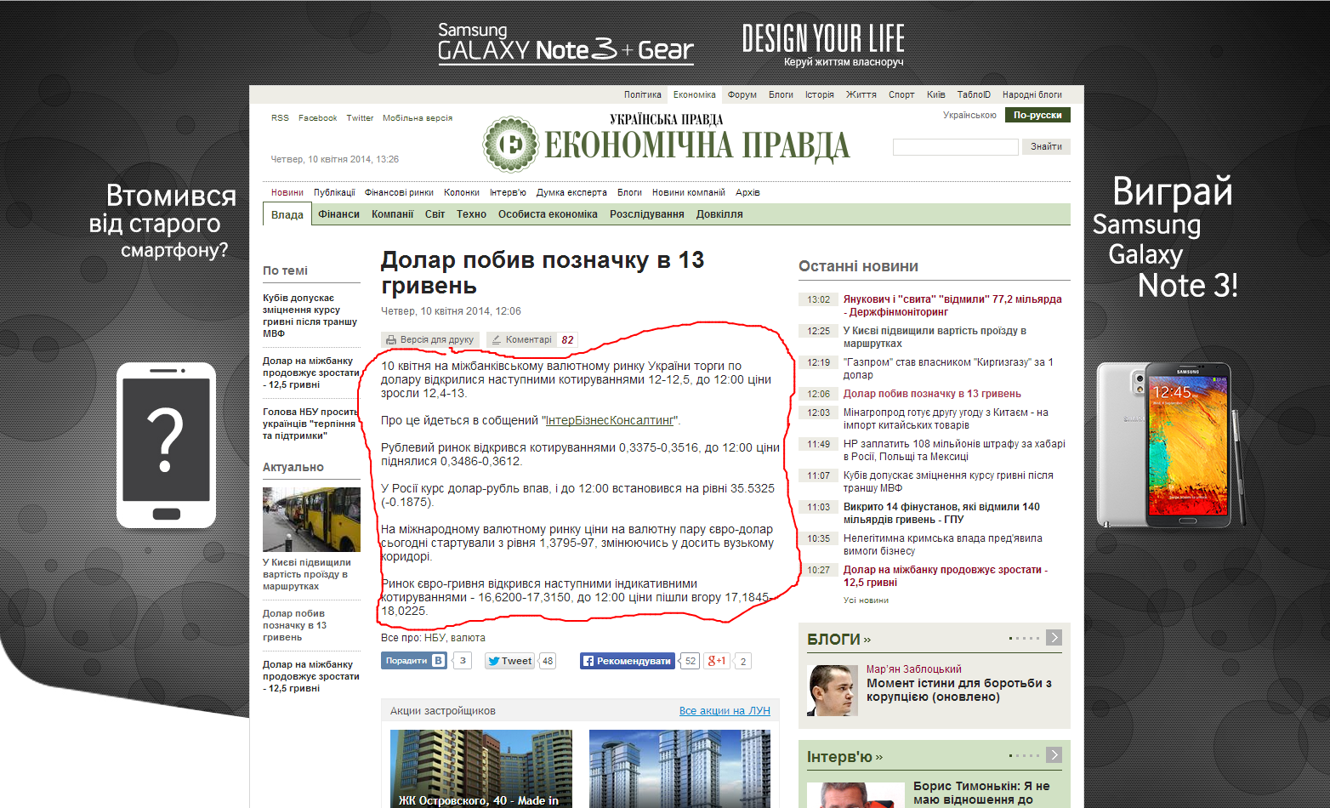
#3: Information waste
Level 1: noisy information such as advertisement, copyright, decoration, etc.
Level 2: useful information, but not very relevant to the topic of the page, such as navigation, directory, etc.
Level 3: relevant information to the theme of the page, but not with prominent importance, such as related topics, topic index, etc.
Level 4: the most prominent part of the page, such as headlines, main content, etc.

Slide 7
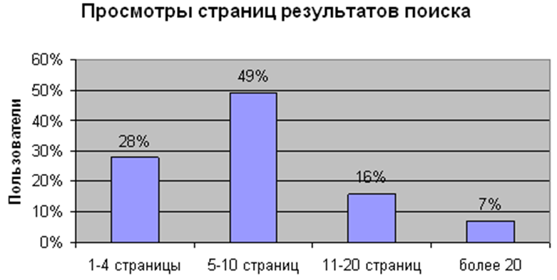
#4: Searching time
Every second user is watching 5-10 pages to find needed information.
My record: 8 hours of uninterrupted search. Found at 23th page on MSN.

Slide 8
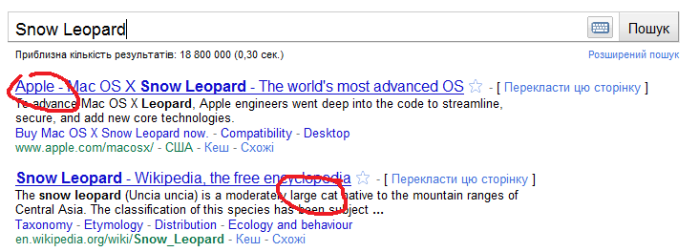
#5: Domain
“Snow Leopard”
Can be “cat” or “operation system” from Apple.

Slide 9
Solutions?
Data Mining – intellectual analysis of big amounts of data
clustering, associated rules, GA, Ant optimization, visualization, decision trees, neural networks.
R&D – new algorithms, methods
Microsoft Research, Yahoo! Research, Google Labs, Arc90 Lab and others.
Let’s mix!

Slide 10
#01: A lot of information
Recommendations based on user’s history and hobbies
Clustering and categorization
Semantic web

Slide 11
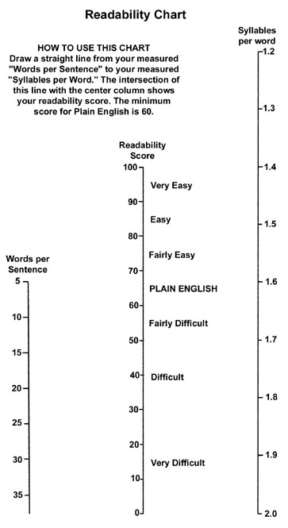
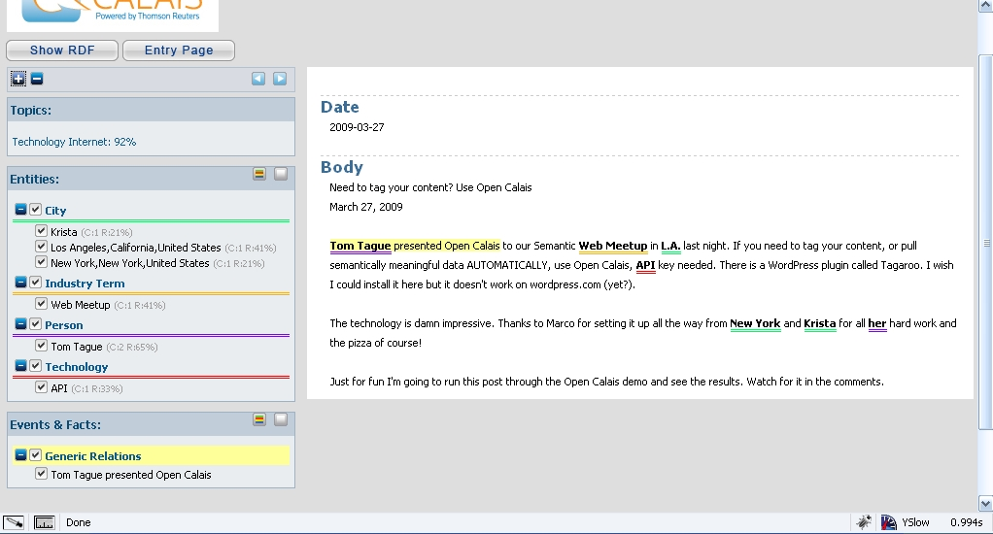
#02: Duplicates. NLP
Readability score
NER Dbpedia Spotlight, Reuters OpenCalais
WordNet
Shingles

Slide 12
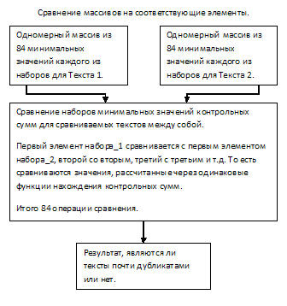
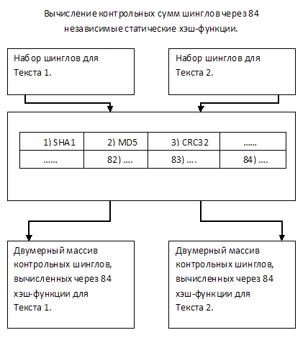
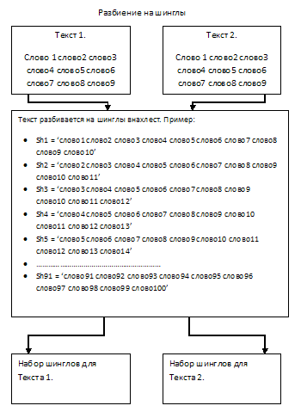
Shingles

Slide 13
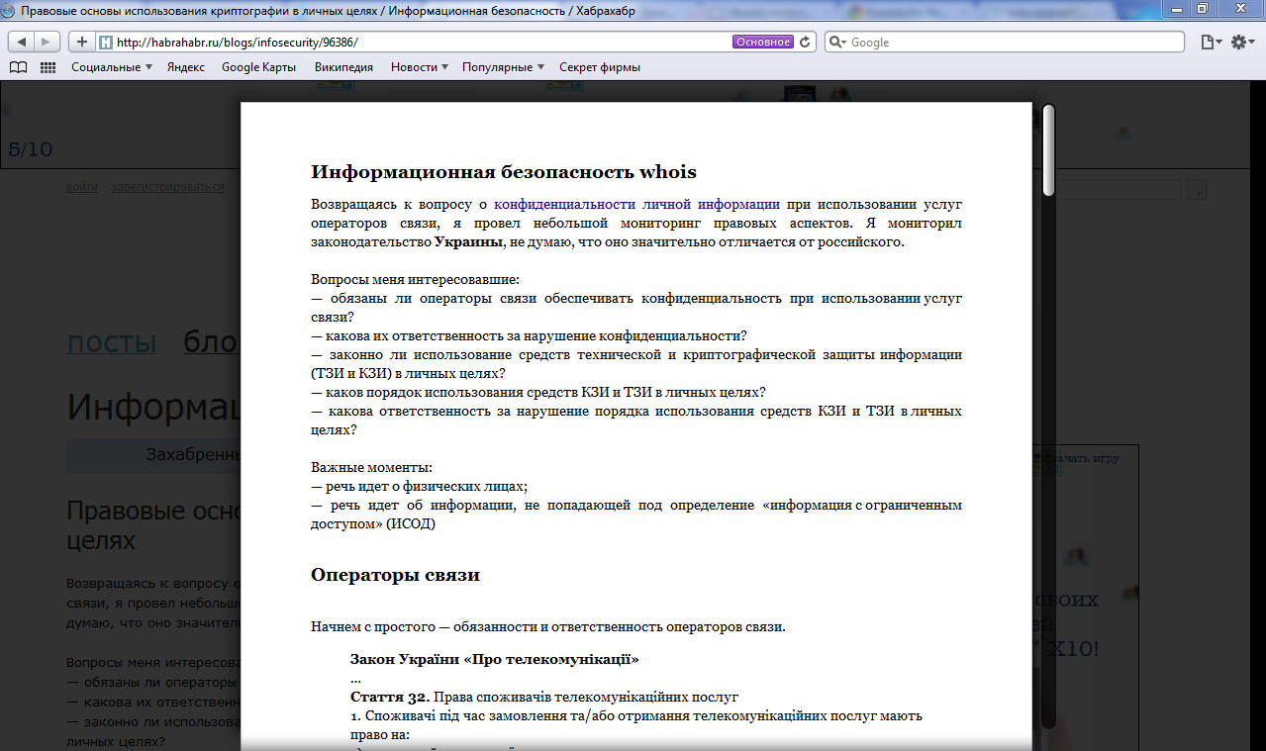
#3: Information waste
Readability
An Arc90 Lab
Readability turns any web page into a clean view for reading now or later on your computer, smartphone, or tablet.
https://www.readability.com

Slide 14
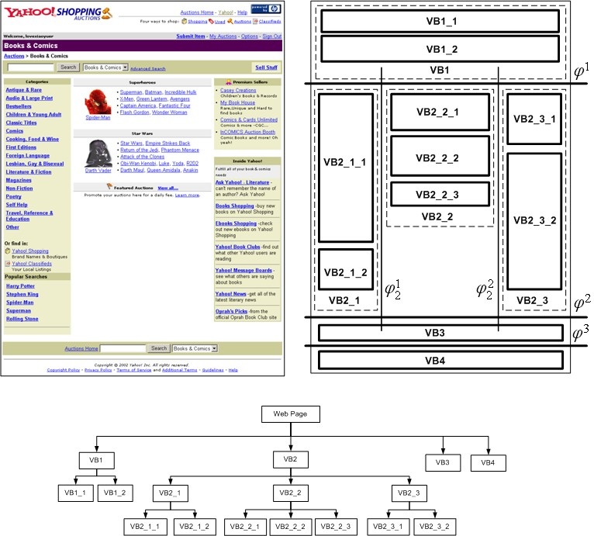
Vision-based Page Segmentation Algorithm
Presents an automatic top-down, tag-tree independent approach to detect web content structure. It simulates how a user understands web layout structure based on his visual perception.
Based on DOM structure analysis and subjective rules.
http://research.microsoft.com/apps/pubs/default.aspx?id=70027

Slide 15
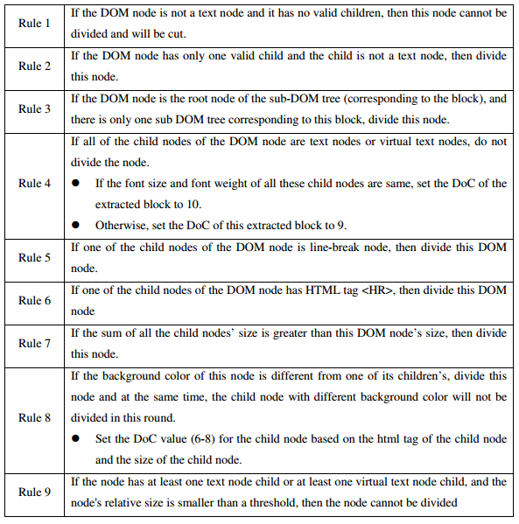
Vision-based Page Segmentation Algorithm
Different pages have different visual margins so quality of segmentation algorithm depends on certain web page.
If comment is bigger than main content (e.g. habrahabr) the result will not be very precise.

Slide 16
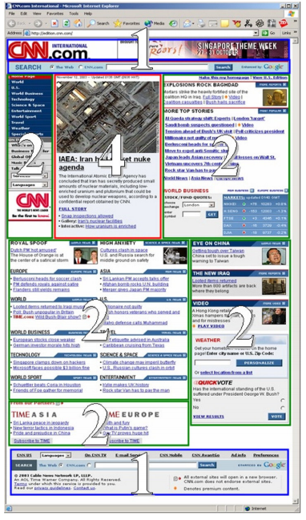
Learning Important Models
Spatial Features {BlockCenterX, BlockCenterY, BlockRectWidth, BlockRectHeight}
Content features {FontSize, FontWeight, InnerTextLength, InnerHtmlLength, ImgNum, ImgSize, LinkNum, LinkTextLength, InteractionNum, InteractionSize, FormNum, FormSize, OptionNum, OptionTextLength, TableNum, ParaNum}
http://www.sigkdd.org/sites/default/files/issues/6-2-2004-12/2-song.pdf

Slide 17
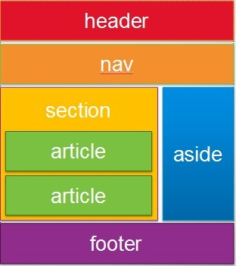
Semantic and SEO
Semantic tags (article, aside, footer, header etc.)
SEO (meta description, keywords)
Microformats (RSS, hCalendar, hCard etc.)
CMS, common engines and social networks.

Slide 18
SeoRank
Title 2 text.
Meta keywords 2 text.
Headers 2 text.
Meta description 2 text.
WordsIndex, SentencesIndex, WordsInSentencesIndex, LinksIndex, WordsAsLinksIndex, ImgsIndex, ImgsAsLinksIndex etc.

Slide 19
Regression model & ML
Detect valuable properties.
Select model type (linear).
After regression analysis we will get content important model:

Slide 20
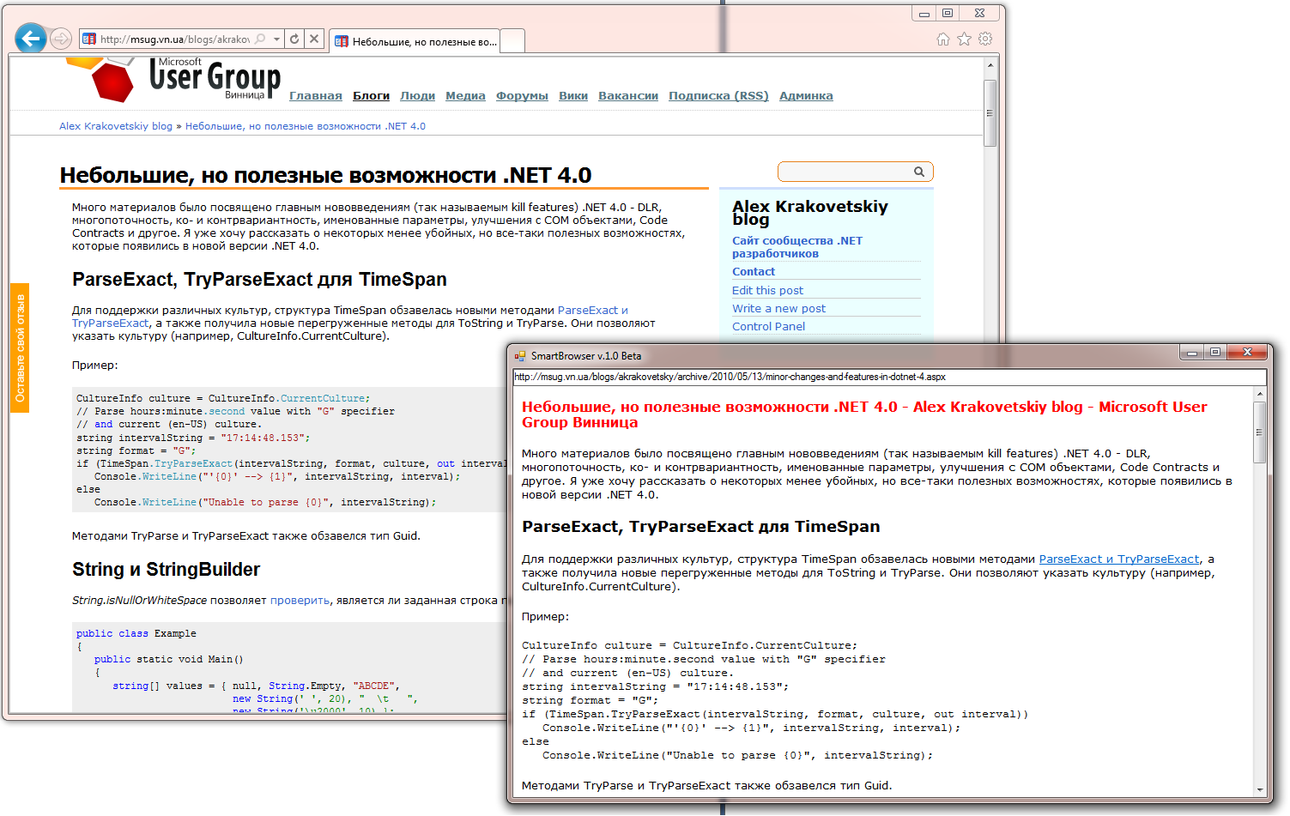
SmartBrowser
Software for determining the most relevant content of the HTML pages.
http://smartbrowser.codeplex.com/

Slide 21
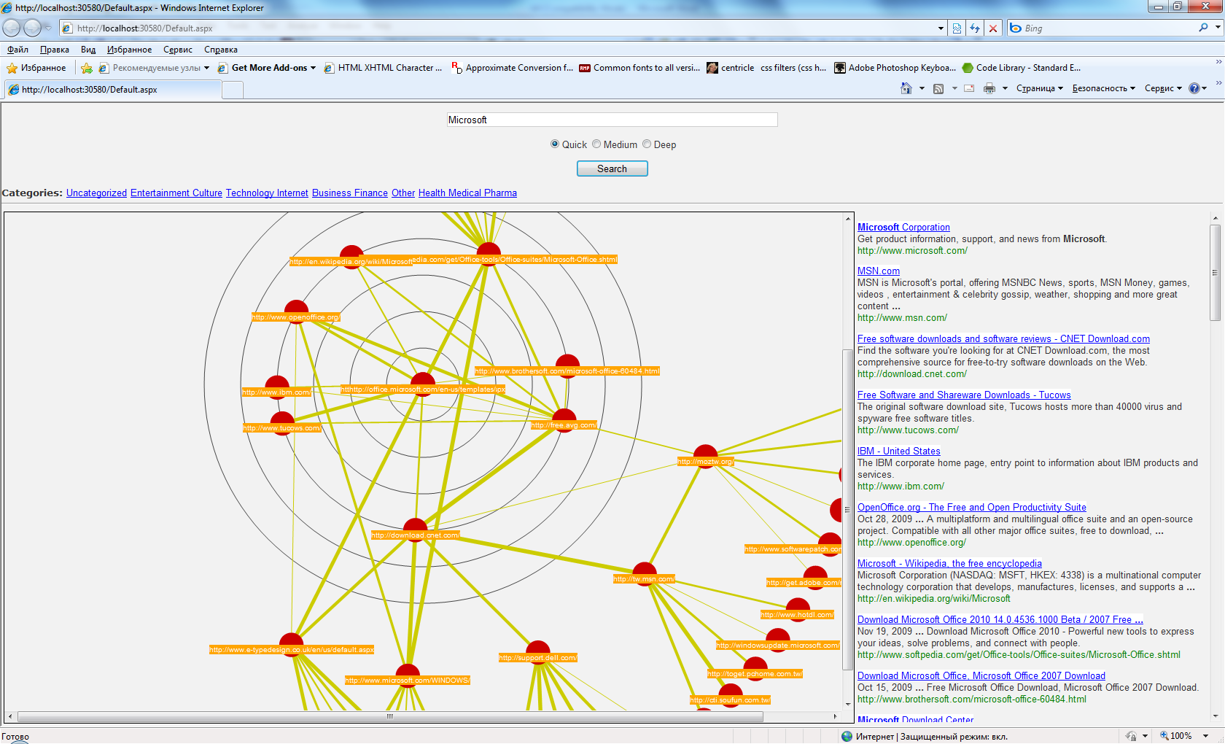
Search optimal path
Graph analysis (similar pages, clustering and categorization).
Ant simulations (search optimal path using complex criterion).
http://touchgraph.com/TGGoogleBrowser.html
http://walk2web.com

Slide 22
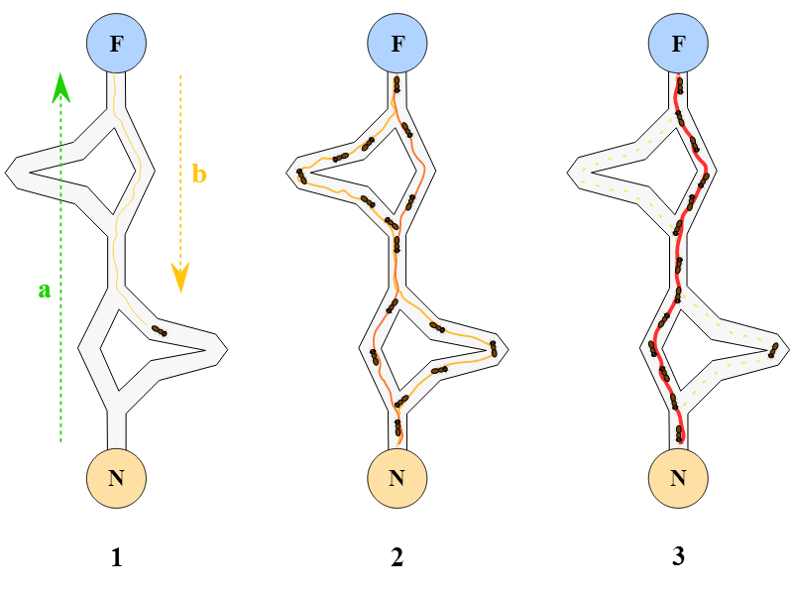
Ant algorithm
The ant colony algorithm is an algorithm for finding optimal paths that is based on the behavior of ants searching for food.
Because the ant-colony works on a very dynamic system, the ant colony algorithm works very well in graphs with changing topologies. Examples of such systems include computer networks, and artificial intelligence simulations of workers.

Slide 23
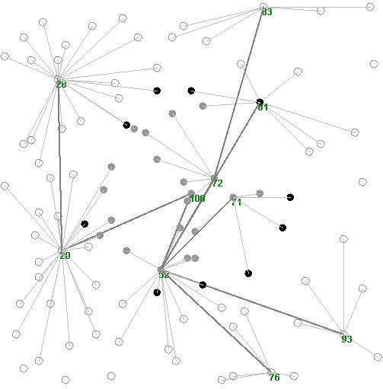
Search optimal path algorithm
User makes a search.
Clustering (removing not relevant cluster pages).
Main content determination and duplicates removal.
Graph structure optimization.
Analyzing content importance and completeness (sorting from most important to less one).
Show the shortest path for viewing searching results.

Slide 24
References
Grammarly http://www.grammarly.com/
Microsoft Research Asia http://research.microsoft.com/en-us/labs/asia/
Information search lectures by Yandex http://company.yandex.ru/public/seminars/schedule
How Google Works Videos http://bit.ly/bRfUav
How Bing Works http://neotracks.blogspot.com/2009/06/ranknethow-bing-works.html
Data Mining hub http://habrahabr.ru/hub/data_mining/
http://cstheory.stackexchange.com/ and http://math.stackexchange.com/
Сравнительный анализ методов определения нечетких дубликатов для Web-документов Зеленков Ю.Г, Сегалович И.В. 2007. http://rcdl2007.pereslavl.ru/papers/paper_65_v1.pdf
Shingles approach http://www.codeisart.ru/part-1-shingles-algorithm-for-web-documents/

Slide 25
Q&A
alex.krakovetskiy@devrain.com
@msugvnua
https://www.facebook.com/alex.krakovetskiy

